Slide 1
Ch 4. Functions and Methods
3. Iterative/Convergence Methods
Pg. 45 - 46

Slide 2
Create a program called LeibnizPiCalculation.java
Week 10

Slide 3

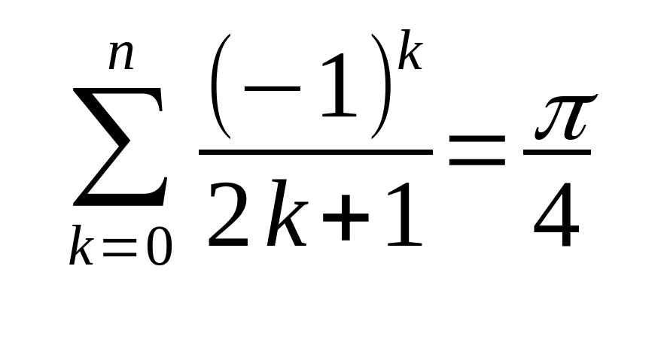
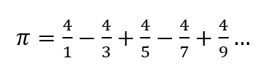
How to calculate the value for pi (𝛑):
The Leibniz Formula
Approximation of pi
Expanding the sum
sum

Slide 4
int sigma = 0;
for(int k = 0; k <= n; k++){
sigma += k;
//Sigma = sigma + k;
}
n
𝚺 ≡
k = 0

Slide 5


Breaking the formula into pieces
getNumerator(): The method shall take a parameter (k) and shall return a double representing the numerator of the series.
getDenominator(): The method shall take a parameter (k) and shall return an int representing the denominator of the series.

Slide 6
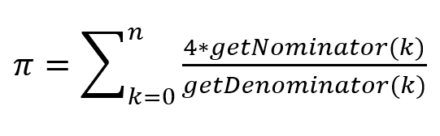
Method Call
getLeibniz( ) will take an int as a parameter (n) that will represent the “limit”. The method calls the other two methods in this form:

Slide 7
Testing the getLeibniz()method
Import java.util.*;
public class LeibnizPiCalculation{
public static void main(String[] args){
Scanner input = new Scanner(System.in);
int n = input.nextInt();
System.out.println("N \t\t Pi");
System.out.println("------------------------");
for(int i = 0; i <= n; i += 100){
System.out.println(i+"\t\t"+getLeibniz(i));
}
}

Slide 8
Output
PS C:\Users\...\desktop> javac LeibnizPiCalculation.java
PS C:\Users\...\desktop> java LeibnizPiCalculation
N: 1000
N Pi
-------------------
0 4.0
100 3.1514934010709914
200 3.1465677471829556
300 3.1449149035588526
400 3.144086415298761
500 3.143588659585789
600 3.143256545948974
700 3.1430191863875865
800 3.142841092554028
900 3.1427025311614294
1000 3.1425916543395442
Pi = 3.14159265359

Slide 9
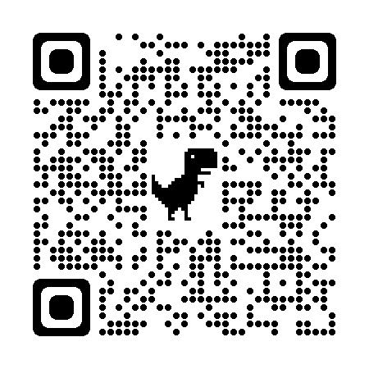
Resources

